Slide 1

BLOODBRIDGE: Optimizing Lifesaving Resources Using AWS Services
This presentation will explore the innovative use of AWS services to enhance the efficiency and effectiveness of blood banks, ensuring life-saving resources reach those in need.

Slide 2
Project Overview
Problem Statement
Solution
Blood banks face challenges in managing inventory, coordinating logistics, and ensuring timely access to blood products.
BLOODBRIDGE leverages AWS services to create a robust platform for efficient blood management, improving donor outreach, and enhancing patient care.

Slide 3




System Architecture
Core Services
1
S3, EC2, Lambda
Data Management
2
DynamoDB, RDS
Security
3
IAM, Cognito
Monitoring and Logging
4
CloudWatch, CloudTrail

Slide 4
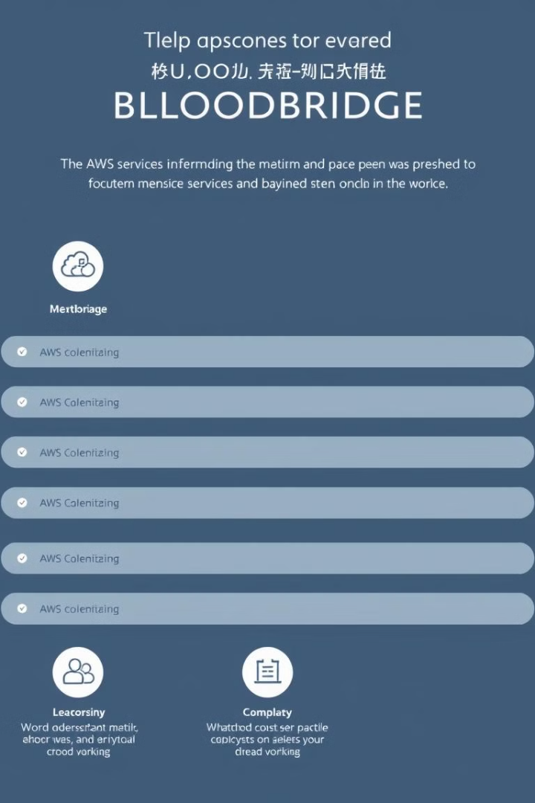
AWS Services Utilized
Amazon S3
Amazon EC2
For secure storage of blood inventory data and associated documents.
Provides virtual servers for running application components and managing data processing.
Amazon DynamoDB
Amazon RDS
A fully managed NoSQL database for fast and scalable storage of blood donation and inventory information.
A managed relational database for storing blood donor and recipient information, providing a secure and reliable data store.

Slide 5
Application Deployment Steps
Step 1
1
Code compilation and testing of the BLOODBRIDGE application in a local development environment.
2
Step 2
Deployment of the application code and configuration files to AWS using automated scripts.
Step 3
3
Configuration of AWS services, including EC2 instances, databases, and security settings.
4
Step 4
Testing the deployed application in a staging environment to ensure functionality and performance before going live.
Step 5
5
Release of the BLOODBRIDGE application to production, making it available to users.

Slide 6

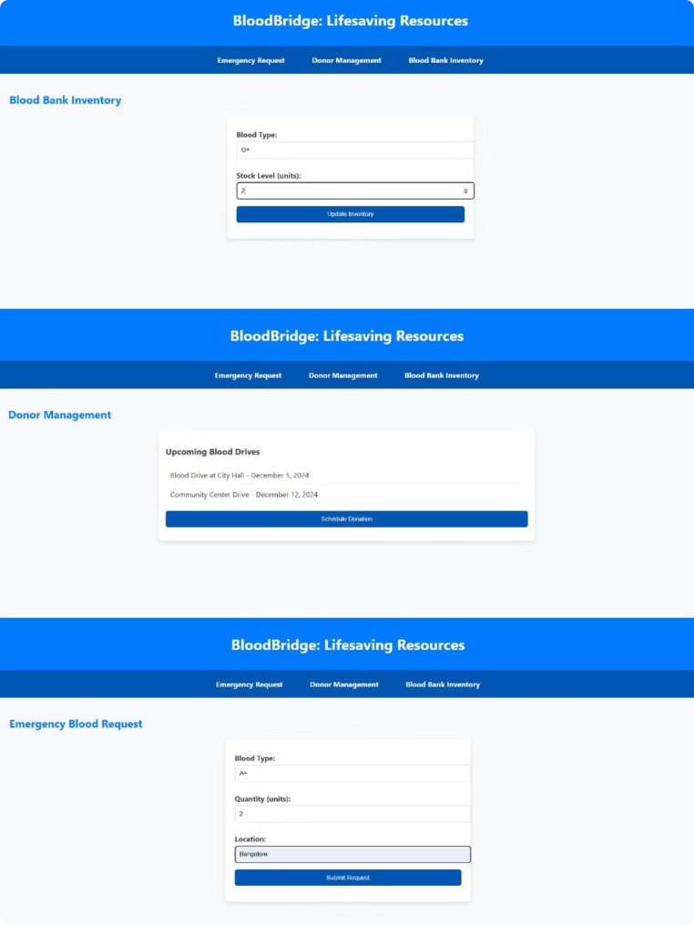



API Endpoints and Documentation
Inventory Management
GET /blood-inventory: Retrieves current blood inventory levels.
Donor Management
POST /donors: Registers new blood donors with their information.
Request Management
POST /requests: Places blood requests from hospitals.

Slide 7
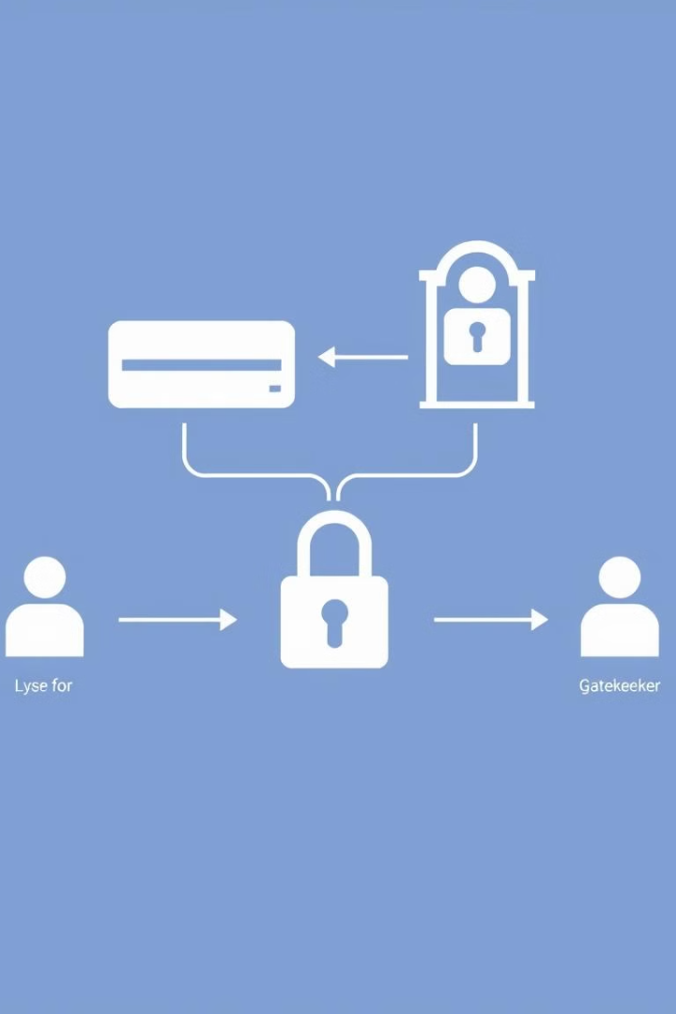


Authentication and Authorization
User Authentication
Users are authenticated using Amazon Cognito, a managed user directory service, for secure logins.
Role-Based Access Control
IAM policies restrict access to specific resources based on the user's role, ensuring data security.

Slide 8

Data Security and Compliance
1
2
Encryption
Firewall Protection
All data is encrypted at rest and in transit using industry-standard algorithms.
AWS security groups and network ACLs restrict unauthorized access to the system.

Slide 9
Testing Strategies and Scenarios
Unit Testing
1
Individual components are tested for functionality and correctness.
Integration Testing
2
Different components are integrated and tested together to ensure smooth interactions.
Performance Testing
3
Load testing and stress testing are performed to assess the system's ability to handle high volume.
Security Testing
4
Vulnerability scans and penetration testing are conducted to identify and mitigate potential security risks.

Slide 10
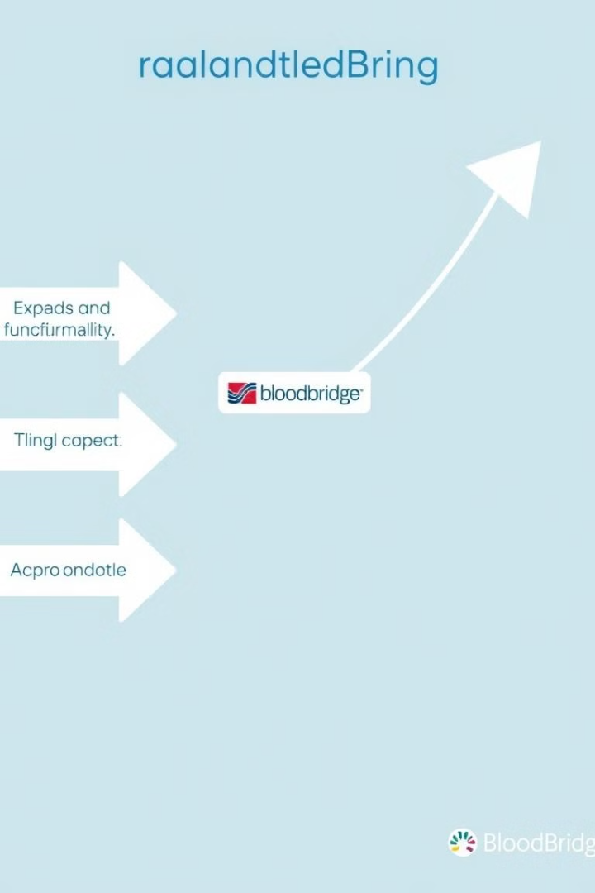
Conclusion and Future Enhancements
BLOODBRIDGE is a transformative solution that addresses critical challenges in blood management, improving efficiency, access, and patient care. Future enhancements include: - Implementing AI-powered predictive analytics for better inventory management. - Expanding the system to integrate with other healthcare systems for seamless information exchange. - Developing mobile applications to empower donors and recipients with real-time updates.

